Slide 1
Thiết Kế Giao Diện
Prototyping
Summer 2022
Some materials adapted from from MIT CS Course 6.813/6.831

Slide 2
Outline
Prototype
  Low- and High-fidelity
  Dimensions of fidelity
Paper prototype
Computer prototype
  Storyboard
  Form builder
  Wizard of Oz

Slide 3

Process for Projects in This Class
0. Propose project
Our topic today
1. Perform user and task analysis
2. Initially design sketches
4. Evaluate prototype
3. Initially prototype
5. Detail prototype
6. Evaluate prototype
7. Implement
8. Perform user testing

Slide 4
Design alternatives
Why we need to express design ideas early?
  You can’t evaluate design until it’s created
  After software is built, changes to the design are difficult
We want
  Make it fast
  Allow lots of flexibility for radically different alternatives
  Low cost
  Promote valuable feedback

Slide 5
What is prototype?
A prototype is an original type, form, or instance of something serving as a typical example, basis, or standard for other things of the same category
Examples
  Screen shots
  Paper drawings
  prototype software - referred to as alpha grade, meaning it is the first version to run

Slide 6
Why we need prototypes?
Experiment with alternative designs
Provide an early, concrete representation of design ideas
Provide hands-on experience for all stakeholders (design teams, users, etc.)
Easier to change or throw away
Keep the design centered on the user
  must test and observe ideas with users
Facilitate iterative design and evaluation
Reduce the risk of making customers surprise
  “I won’t believe it until I see it”

Slide 7
Prototype fidelity
Low-fidelity
  a set of sketches/storyboards providing a static, non-computerized, non-working mockup of the planned product
  omits details
High-fidelity
  a set of screens that provide a dynamic, computerized, working model of the planed product
  working software

Slide 8
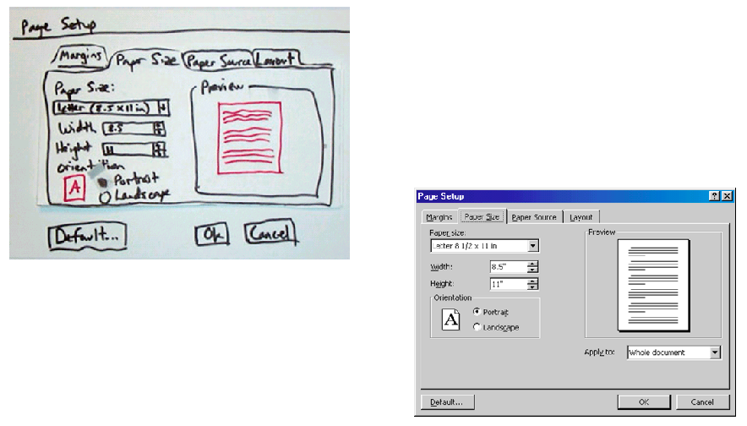
Prototype fidelity (cont’d)

Slide 9
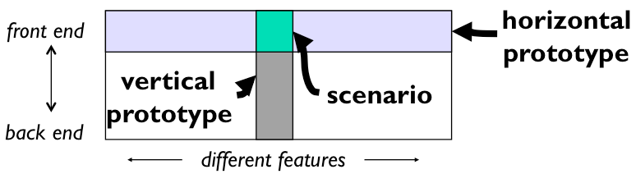
Dimensions of fidelity
Horizontal
  Prototypes cover many features but with little detail
Vertical
  Prototypes cover few features but with much in detail
Diagonal
  Prototypes cover down to a certain level and vertical

Slide 10
Dimensions of fidelity (cont’d)
Look
  Is the appearance and graphic design of the UI
  Can be sketchy and hand-drawn
Feel
  Referring to input methods to interact with the UI
  Pointing and writing (in paper-mockup) is different from mouse and keyboard
Can paper prototype have the feel attribute?

Slide 11
Paper prototype - Videos
“Example Usability Test with a Paper Prototype”
“Hanmail Paper Prototype”
“Paper prototype usability test”
Find these videos on Youtube

Slide 12
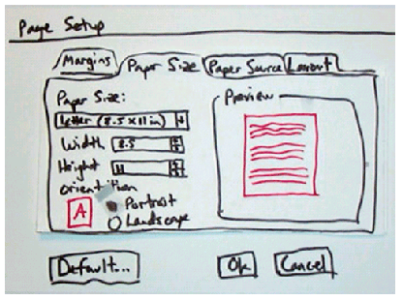
Paper prototype
Using paper mockup to represent the UI
  Sketches of screen appearance
  Paper pieces show windows, menus,
  dialog boxes, toolbars

Slide 13
Paper prototype (cont’d)
Interaction
  Pointing with a finger = mouse click
  Writing = typing
A person simulates the computer’s operation
  Putting down and picking up pieces
  Writing responses on the mockup (screen)
  Describing effects that are hard to show on paper

Slide 14
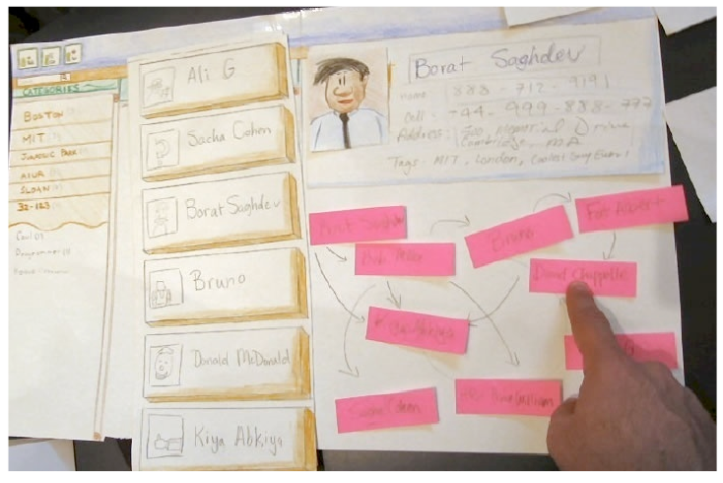
Paper prototype (cont’d)

Slide 15
Paper prototype (cont’d)
Characteristics
  Low fidelity in look and feel
  High fidelity in depth as there is person to simulate the operation

Slide 16
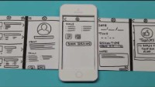
https://www.youtube.com/watch?v=y20E3qBmHpg

Slide 17
Paper prototype (cont’d)
Advantages
  Faster to build
  Easier to change
  Cheap
  Focuses attention on big picture
    Designers don’t waste time on details
    Attract ideas from customers
  Non-programmers can help
  Convenient
    You can prototype on the bus
    You can utilize your time efficiently

Slide 18
Tools for paper prototyping
White poster board
  Used as background or window frame
Index cards
Re-stickable glue
White correction type
Photocopier
  For making copies
Pens, markers, scissors, type
Etc.

Slide 19
Exercise
Work on paper prototypes for your app
  1 – 2 main screens
Take photos of your protoype and share
Time: 15 minutes

Slide 20
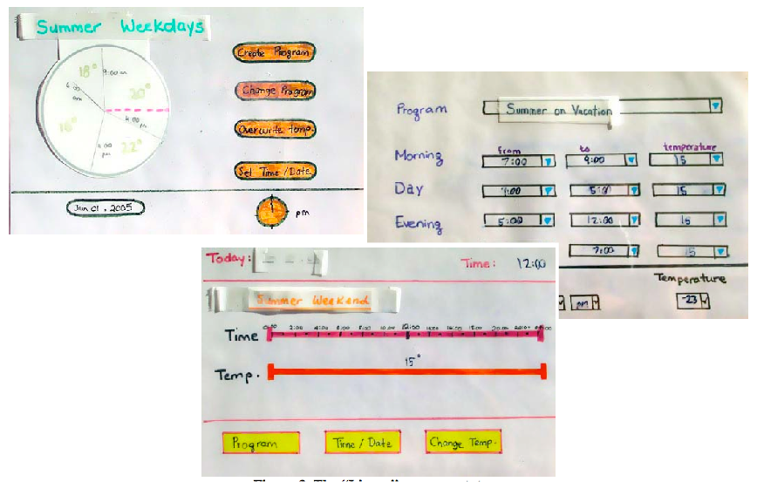
Tips for good paper prototypes
Make it large
Make it monochrome (single color)
Use description where necessary
  You cannot represent tricky interactions like drag & drop, animation, progress bar
Keep pieces organized
  Use folders and envelopes
Produce multiple alternatives
  Better to get feedback

Slide 21
What can paper prototypes help?
It helps better understanding of
  conceptual model
    Do users understand the UI?
  functionality of the system
    What features are missing in the UI?
  navigation and task flow
    Do users understand the navigation of the UI?
  terminology
    Are terms and levels understood?
  screen content and layout
    What are there in the UI?

Slide 22
What it does not help?
Showing “look”: color, font, whitespace, etc.
Demonstrating “feel”: efficiency issues
  Interactions are in low fidelity (not real)
Measuring response time
Demonstrating animation and high-level of interaction
  Actions like drag and drop, drawing, etc.

Slide 23
Computer prototype
Interactive software simulation
High-fidelity in look & feel
Low-fidelity in depth
  May be no backend, covering horizontally
  Does not have a human simulating the backend like paper prototype

Slide 24
What can computer prototypes help?
Everything from paper prototypes, plus
Better and higher-fidelity look
  Screen layout
  Colors, fonts, icons, etc.
  Choices of controls
Interactive feedback
Efficient issues
  Controls are big enough?
  Whitespace?
  Distance between controls?

Slide 25
Advantages of computer prototype
Faster than coding
No debugging
Easier to change and throw away
Separate UI design ideas from what offered by UI toolkit (e.g., Visual Studios, C++ Builder)
  Your thinking is not limited to available widgets
Non-programmers can do it

Slide 26
Computer prototyping techniques
Storyboard
  Sequence of painted screenshots, sometimes connected with links
Form builder
  Creating real windows with widgets such as buttons, windows, labels, etc.)
Wizard of Oz
  Computer frontend, human backend

Slide 27
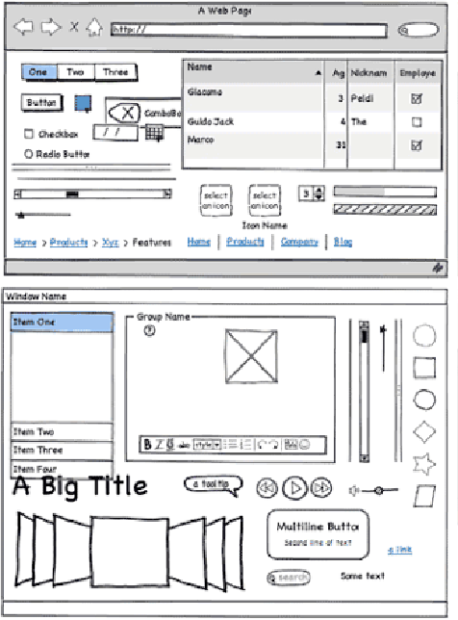
Computer prototyping techniques (cont’d)
Storyboarding tools
  Figma
  Powerpoint
  invision
  Photoshop
  Balsamiq Mockup
  Mockingbird
  Justinmind
  Axure
  Pidoco
  Excel
  Visio
  Etc.

Slide 28
Computer prototyping techniques (cont’d)
Storyboarding tools
  Pros
    You can draw anything
    Fast
  Cons
    No or limited interaction
      No text entry
      Widgets aren’t active

Slide 29
Computer prototyping techniques (cont’d)
Form builders
  FlexBuilder
  Silverlight
  Visual Basic
  C++ Builder
  Visual C#
  Qt Designer

Slide 30
Computer prototyping techniques (cont’d)
Form builders
  Pros
    Actual controls → high-fidelity in terms of look
    You can reuse the design for implementation → save effort from doing again
  Cons
    Limits thinking to standard and available widgets
    Content in each widget is not visible

Slide 31
Computer prototyping techniques (cont’d)
Wizard of Oz
  “Wizard of Oz” = “man behind the curtain”
  Software simulation with human in the loop to help
    Human “wizard” mimics computational functionalities
      system response interprets user input
      controls computer to simulate appropriate output
    Wizard is not always hidden
  Example
    Simulate the speech recognition which is not available (human is needed to recognize speech)

Slide 32
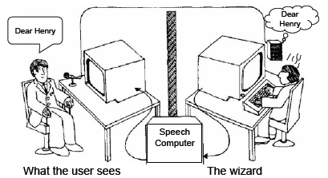
Computer prototyping techniques (cont’d)
Wizard of Oz
  Faking the interaction
  Issues
    Wizard has to be mechanical (pretending to be non-human)
    Worry about both UIs: for wizard and users

Slide 33
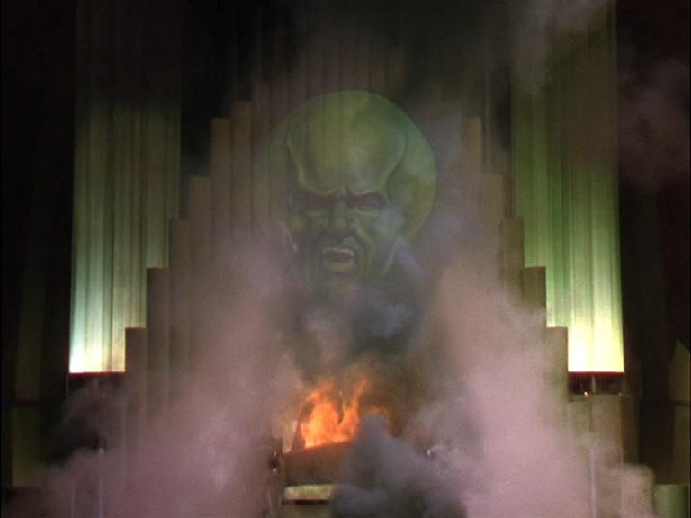
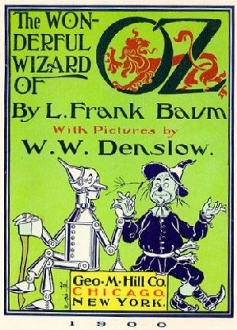
Notes:
Wizard of Oz is a powerful prototyping approach that is worth considering.
In the Wizard of Oz, Dorothy is whisked away by a tornado to a magical land called Oz. She’s told that the only person who can get her home is the “Wizard of Oz,” so she goes on a quest to find the wizard (along with a tin man, a scarecrow, and a cowardly lion). When she finally meets the Wizard, she finds this impressive-looking floating green head that everybody is afraid of. But…
Text adapted from: http://en.wikipedia.org/wiki/Wizard_of_Oz_experiment
Image 1 source: http://www.uktheatretickets.co.uk/shows/The-Wizard-of-Oz-Tickets
Image 2 source: http://thewizardofoz.info/

Slide 34
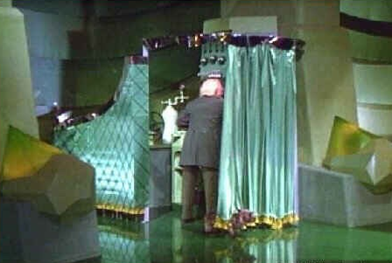
Notes:
… when Dorothy’s dog Toto pulls back a screen in a corner of the room, she finds a very unimpressive old guy controlling the floating green head with dials and levers. There’s the REAL Wizard!
John F. ("Jeff") Kelley used the terms "Wizard of OZ" and "OZ Paradigm" to describe the prototyping method he developed while doing his dissertation work at The Johns Hopkins University around 1980. (John’s dissertation advisor was Professor Alphonse Chapanis, the "Godfather of Human Factors and Engineering Psychology").
Jeff was working on speech recognition systems, and he had a problem. He needed to know how the interface would work before he would know what words the system should recognize. But he needed the recognizer to work before he could try out a user interface design!
Jeff’s solution was build a prototype that looked like a complete system, but it actually had a human being playing the part of the recognizer. This allowed Jeff to try out user interface designs before he had a working recognizer.
So you see, you can give users an interface that looks very impressive, even though it’s being controlled by a “man behind a curtain.” Amusingly enough, Jeff’s study actually had a curtain separating him (the "Wizard“), from view during the study.
Text adapted from: http://en.wikipedia.org/wiki/Wizard_of_Oz_experiment
Image 1 source: http://acidemic.blogspot.com/2010/07/great-acid-cinema-wizard-of-oz-1939.html

Slide 35
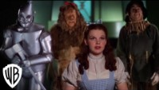
https://www.youtube.com/watch?v=-RQxD4Ff7dY

Slide 36
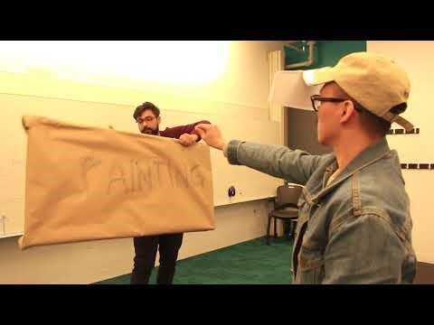
https://www.youtube.com/watch?v=yYIdT0cunhI

Slide 37
Exercise 2
Work with your project team
Discuss with your team mates to select the best paper prototype
Convert the selected paper protoype into computer prototypes using a software tool
25 minutes
Present 5 minutes each

Slide 38
Summary
Prototype
  Low- and High-fidelity
  Dimensions of fidelity
Paper prototype
Computer prototype
  Storyboard
  Form builder
  Wizard of Oz

